Slide 1
TriangleKV: Reducing Write Stalls and Write Amplification in LSM-tree Based KV Stores with Triangle Container in NVM
TPDS 2022
Chen Ding, Ting Yao, Hong Jiang, etc.
Huazhong University of Science and Technology

Slide 2
Introduction
To better understand LSM-tree based KV stores, this paper experimentally evaluated the popular RocksDB with conventional systems of DRAM-SSD storage, and made observations that point to two challenging issues and their root causes.
First, write stalls lead to application throughput periodically dropping to nearly zero, resulting in dramatic fluctuations of performance and long-tail latencies. the main cause of write stalls is the large amount of data processed in each L0-L1compaction.
Second, write amplification (WA) degrades system performance and storage devices’ endurance. WA is directly related to the depth of the LSM-tree as deeper tree resulting from larger datasets increases the number of compactions.
Targeting these two challenges and their root causes, this paper proposes TriangleKV, an LSM-tree based KV store for systems with DRAM-NVM-SSD storage. The design principle behind TriangleKV is leveraging NVM to
(1) construct cheaper and finer granularity compaction for L0 and L1
(2) reduce LSM-trees’ depth to mitigate WA

Slide 3
Background & Motivation
NVM & LSM-tree based KV stores
Systems with DRAM-NVM-SSD storage are recognized as a promising way to utilize NVMs due to the following three reasons:
First, NVM is expected to co-exist with large-capacity SSDs for the next few years;
Second, compared to DRAM, NVM still has 5 times lower bandwidth and 3 times higher read latency;
Third, a hybrid system balances the TCO and system performance;
As a result, TriangleKV focuses on efficiently using NVMs as persistent memory in a hybrid system of DRAM, NVMs, and SSDs.

Slide 4
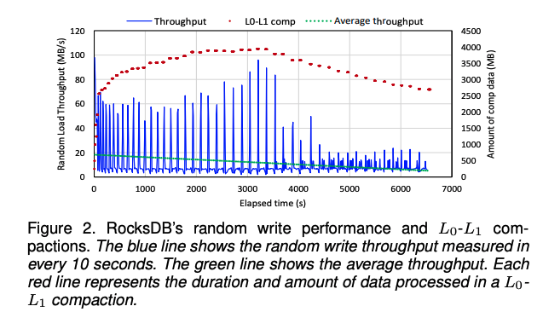
Background & Motivation
Write Stalls
In an LSM-based KV store, there are three types of possible stalls
Insert stalls: if MemTable fills up before the completion of background flushes, all insert operations to LSM-trees are stalled
Flush stalls: if L0 has too many SSTables and reaches a size limit, flushes to storage are blocked.
Compaction stalls: too many pending compaction bytes block foreground operations.
All these stalls have a cascading impact on write performance and result in write stalls.

Slide 5
Background & Motivation
Write Amplification
Write amplification (WA) is defined as the ratio between the amount of data written to storage devices and the amount of data written by users
The growing size of the dataset increases the depth of an LSM-tree as well as the overall WA.
For example, the WA factor of compacting from L1 to L2 is AF. And, the WA factor of compacting from L1 to L6 is over 5 × AF.
The increased WA consumes more storage bandwidth, competes with flush operations, and ultimately slows down application throughput.

Slide 6
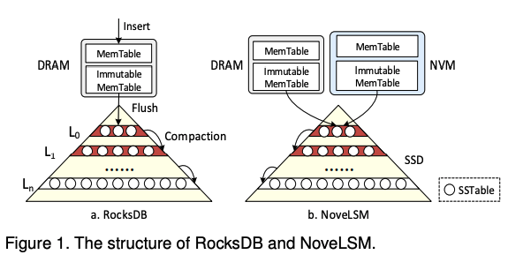
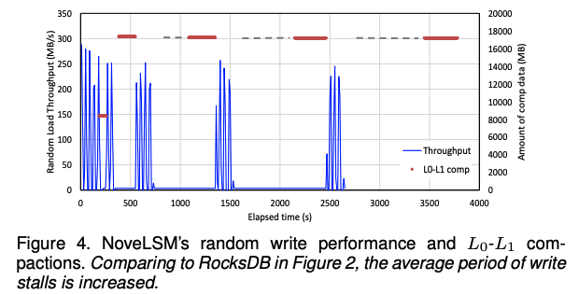
Background & Motivation
NoveLSM
NoveLSM exploits NVMs to deliver high throughput for systems with DRAM-NVM-SSD storage. The design choices of NoveLSM include:
adopting NVMs as an alternative DRAM to increase the size of MemTable and immutable MemTable;
making the NVM MemTable mutable to allow direct updates thus reducing compactions.
However, these design choices merely postpone the write stalls.

Slide 7
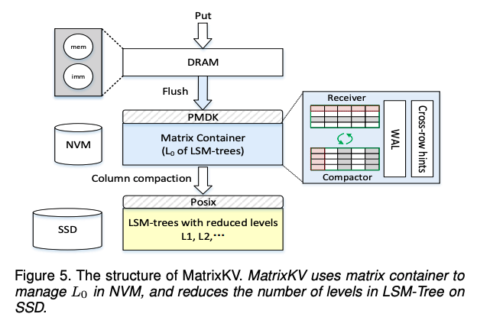
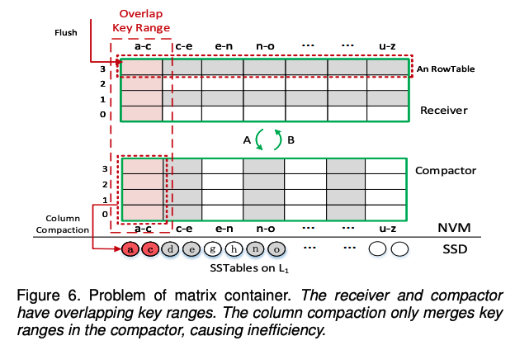
Background & Motivation
MatrixKV
MatrixKV is designed to provide a stable low-latency KV store via intelligent use of NVM. The design choices of MatrixKV include:
manages MemTable and immutable MemTable in DRAM and put WAL in NVM
lifts L0 of LSM-Tree to NVM
manages L0 using a matrix container which comprises one receiver and one compactor.
However, the column compaction is only performed for the compactor, and the key ranges overlapping with the compactor in the receiver cannot participate in the compaction process.

Slide 8
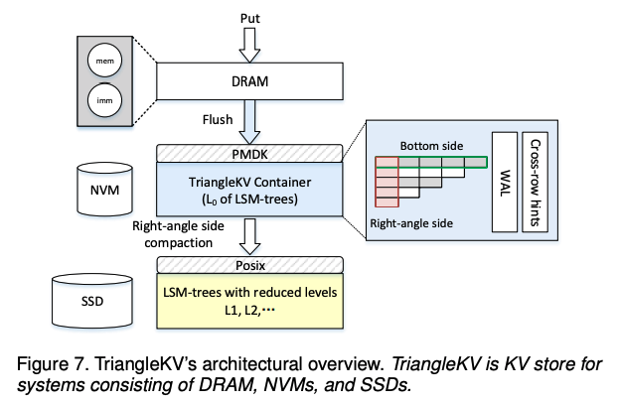
Design
TriangleKV builds and improves on MatrixKV by replacing the latter’s matrix data structure with a more efficient management structure in L0 , a triangular data structure.
DRAM batches writes with MemTables
MemTables are flushed to L0 that is stored and managed by a triangle container in NVMs
data in L0 are compacted to L1 in SSDs through right-angle side compactions
SSDs store the remaining levels of a flattened LSM-tree

Slide 9
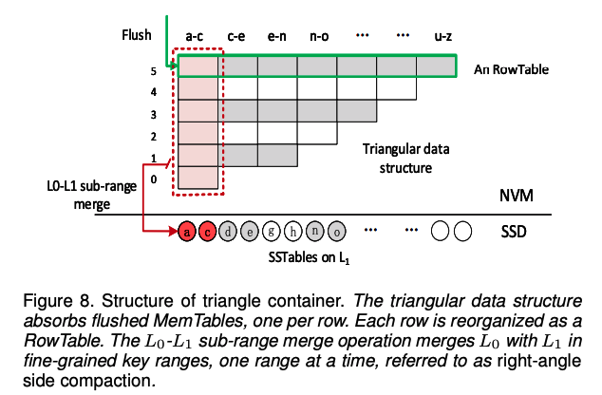
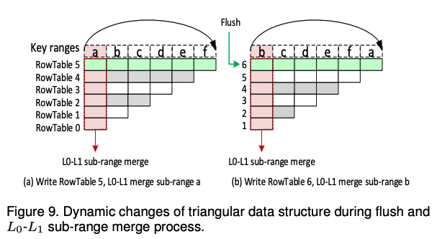
Design
Triangle Container
Triangular data structure
TriangleKV elevates L0 from SSDs to NVMs and reorganizes L0 into a triangle container to exploit the byte-addressability and high-speed random accesses of NVMs. Triangle container is a data management structure for L0 of LSM-trees.

Slide 10
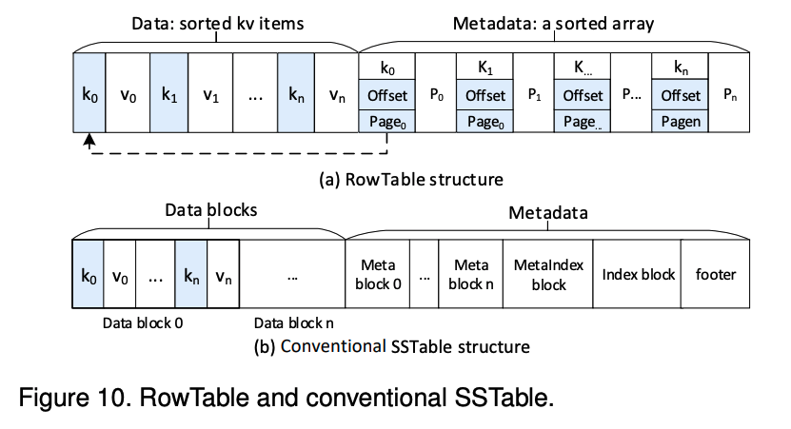
Design
Triangle Container
RowTable
The RowTable structure consisting of data and metadata.
serialize KV items from the immutable MemTable in the order of keys and store them to the data region
build the metadata for all KV items with a sorted array

Slide 11
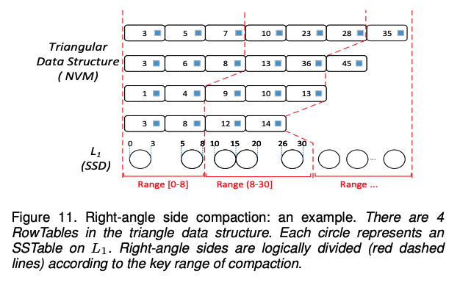
Design
Right-angle Side Compaction
Right-angle side compaction is a fine-grained L0-L1 compaction that each time compacts only a right-angle side, i.e., a small subset of the data in a specific key range.
Thus, right-angle side compaction is able to significantly reduce write stalls.

Slide 12
Design
Reducing LSM-tree Depth
TriangleKV reduces the number of LSM-tree levels by increasing the size limit of each level at a fixed ratio making the AF of adjacent levels unchanged.
As a result, for compactions from L1 and higher levels, the WA of compacting an SSTable to the next level remains the same AF but the overall WA is reduced due to fewer levels.
Flattening conventional LSM-trees with larger level widths brings two negative effects.
First, since the enlarged L0 has more SSTables that overlap with key ranges, the amount of data in the L0-L1 compaction increases significantly, which not only adds the compaction overhead but also lengthens the duration of write stalls.
Second, the search efficiency decreases as we must traverse a larger unsorted L0.

Slide 13
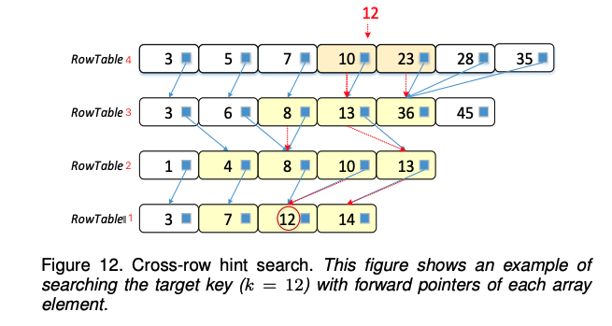
Design
Cross-row Hint Search
Constructing cross-row hints
When build a RowTable in the triangle container, add a forward pointer for each element in the sorted array of metadata.
Search process in the triangle container
A search process starts from the latest arrived RowTable i.
If the key range of RowTable i does not overlap the target key, we skip to its preceding RowTable i−1.
Else, we binary search RowTable i to find the key range where the target key resides.

Slide 14
Implementation
TriangleKV accesses NVMs via the PMDK library and accesses SSDs via the POSIX API .
Write
Write requests from users are inserted into a write-ahead log on NVMs to prevent data loss from system failures.
Data are batched in DRAM, forming MemTable and immutable MemTable.
The immutable MemTable is flushed to NVM and stored as a RowTable in triangle container, forming the bottom-side of the triangular data structure.
Data in the triangular data structure is right-angle side compacted with SSTables in L 1one by one.
In SSDs, SSTables are merged to higher levels via conventional compactions as RocksDB does.
Read
TriangleKV processes read requests in the same way as RocksDB. The read thread searches with the priority of DRAM>NVMs>SSDs.
In NVMs, the cross-row hint search contributes to faster searches among different RowTables of L 0.

Slide 15
Evaluation
Experiment Setup
All experiments are run on a test machine with two Genuine Intel(R) 2.20GHz 24-core processors and 32 GB of memory
The kernel version is 64-bit Linux 4.13.9 and the operating system in use is Fedora 27
The experiments use two storage devices, an 800 GB Intel SSDSC2BB800G7 SSD and 256 GB NVMs of two 128 GB Intel Optane DC PMM
Mainly compare TriangleKV with MatrixKV, NoveLSM and RocksDB(including RocksDB-SSD and RocksDB-L0-NVM)
The other four KV stores are for systems with DRAM-NVM-SSD storage.
Their NVM in use is 8 GB, being consistent with the experiments in Nove-LSM’s paper.

Slide 16
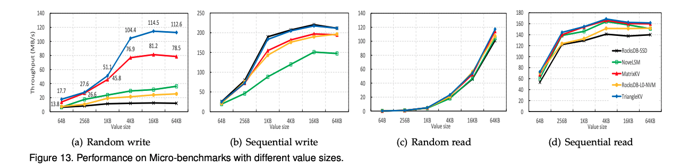
Evaluation
Overall performance evaluation
Write
random write performance by inserting KV items totaling 80 GB in a uniformly distributed random order
sequential write performance by inserting a total of 80 GB KV items in sequential order
Read
Random/sequential read performances are evaluated by reading one million KV items from the 80 GB randomly loaded database.

Slide 17
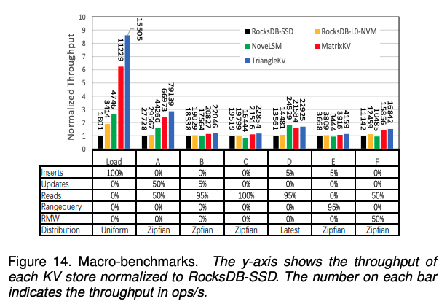
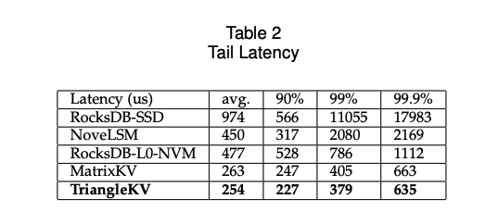
Evaluation
Overall performance evaluation
Macro-benchmarks
evaluate five KV stores with YCSB
first write an 80 GB dataset with 4KB values for loading, then evaluate workload A-F with one million KV items respectively
Tail latency

Slide 18
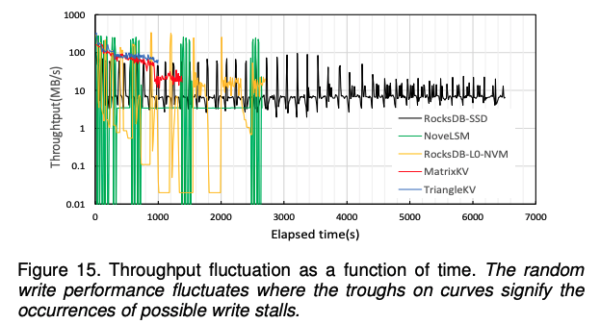
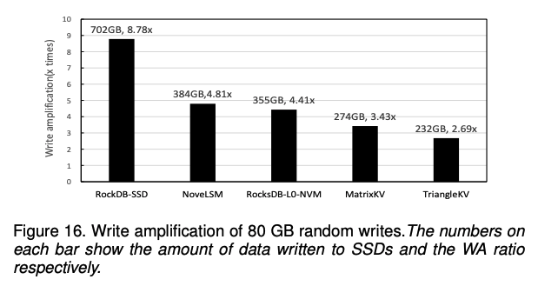
Evaluation
Performance Gain Analysis
Write Stalls
record the random write throughput for the five KV stores in every ten seconds to visualize write stalls
Write Amplification
measure the WA of five systems on the same experiment of randomly writing 80 GB dataset

Slide 19
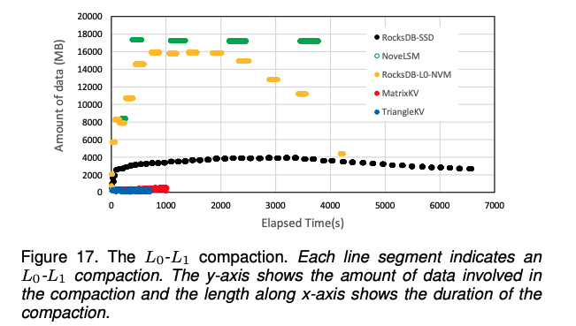
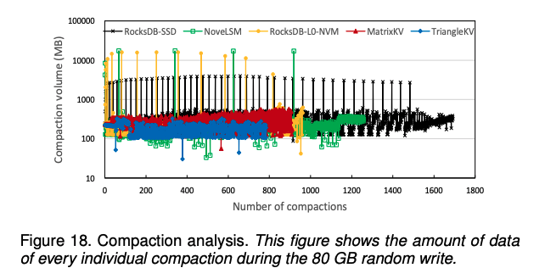
Evaluation
Performance Gain Analysis
Right-angle side compaction
record the amount of data involved, the starting and ending times of every L0-L1 compaction for five KV stores during the 80 GB random write experiment.
Overall compaction efficiency
record the overall compaction behaviors of five KV stores by recording the amount of data for every compaction during the random write experiment.

Slide 20
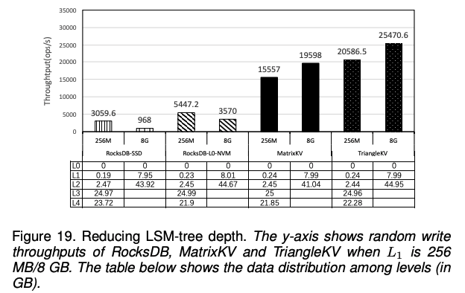
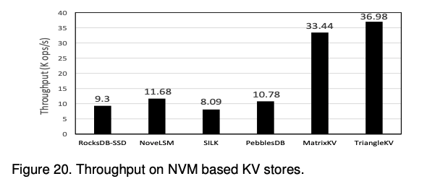
Evaluation
Performance Gain Analysis
Reducing LSM-tree depth
To evaluate the technique of flattening LSM-trees, change level sizes for both RocksDB, MatrixKV and TriangleKV
The first configuration is L1 = 256MB, the second configuration is L1= 8GB.
Cross-row hint search
To evaluate the technique of cross-row hint search, first randomly write an 8 GB dataset with 4 KB value size to fill the level in NVMs for TriangleKV and RocksDB-L0-NVM. Then search for one million KV items from NVMs in uniformly random order.

Slide 21
Conclusion
TriangleKV is designed for systems with multi-tier DRAM-NVM-SSD storage.
By lifting the L0 to NVM, managing it with the triangle container, and compacting L0 and L1 with the fine granularity right-angle-side compaction, TriangleKV reduces write stalls.
By flattening the LSM-trees, TriangleKV mitigates write amplification.
TriangleKV also guarantees adequate read performance with cross-row hint searches.
TriangleKV builds and improves on MatrixKV to reduce unnecessary writes by using a dynamic triangular data structure.

Slide 22

Q & A
Thank You!

